Slide 1
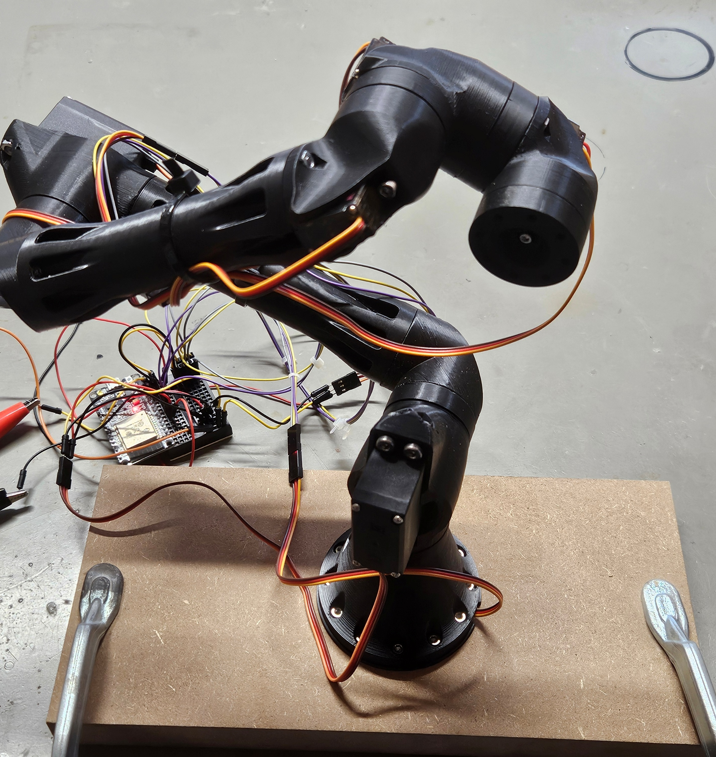
Cyber-Zero
Gustavo Carneiro Da Costa. x22104020
Autonomous Chess-Playing Robotic Arm — Midpoint Project Presentation

Slide 2
Agenda
Cyber-Zero
Autonomous robotic system designed to play chess
System architecture
Combines artificial intelligence with robotic control
Why simulation at midpoint
Human player interacts via Raspberry Pi touchscreen
ROS2 & Gazebo simulation
Robotic arm executes all chess moves physically
Midpoint progress & Next steps

Slide 3
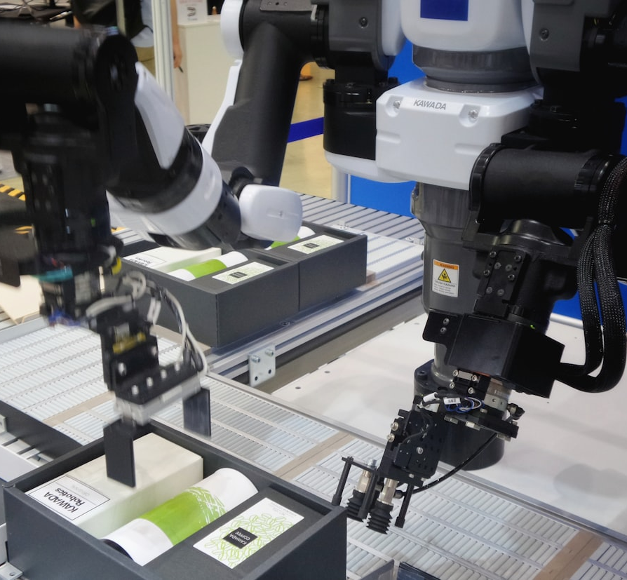
Overview
Cyber-Zero
Overview
• Autonomous robotic system designed to play chess • Combines artificial intelligence with robotic control • Human player interacts via Raspberry Pi touchscreen • Robotic arm executes all chess moves physically

Slide 4

Architecture
Cyber-Zero
Architecture Overview
• Distributed system architecture • Desktop PC runs AI chess engine (CNN + MCTS) • Raspberry Pi runs UI and ROS2 control nodes • Arduino handles low-level motor actuation • Components communicate over the internet

Slide 5

Simulation Rationale
Cyber-Zero
Simulation Rationale
• Physical hardware introduces safety and debugging risks • Simulation enables safe and repeatable testing • Validates motion planning and collision avoidance • Testing and prototyping in simulation is done faster

Slide 6
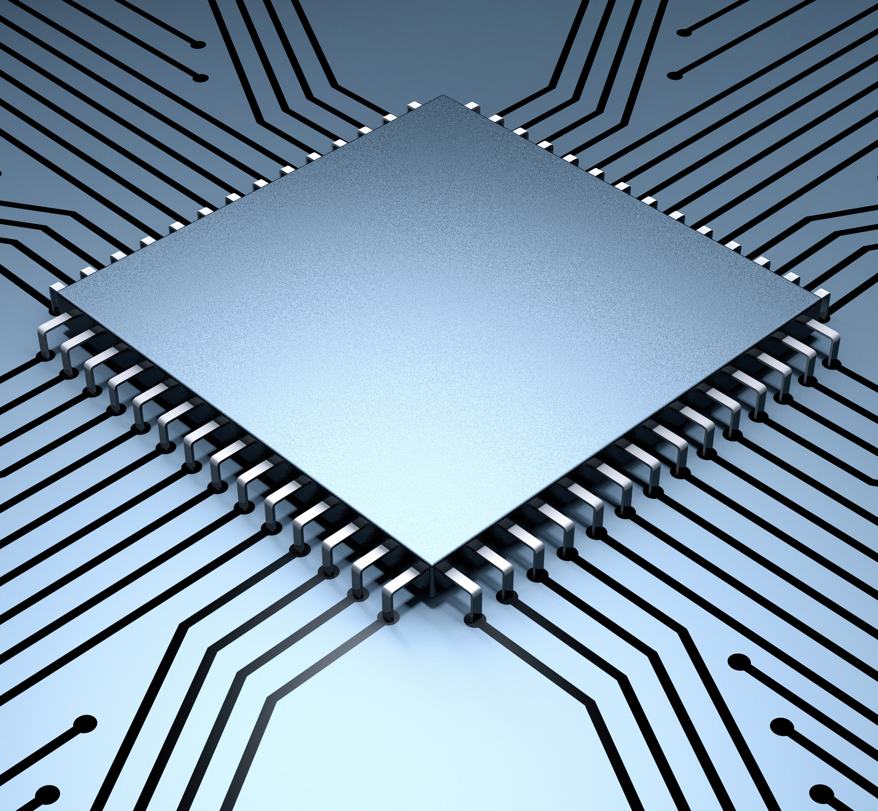
ROS2 & Gazebo
Cyber-Zero
ROS2 & Gazebo
• ROS2 manages robotic motion and coordination • Gazebo simulates robotic arm and chessboard • Inverse kinematics used for joint movement • Collision-free trajectories enforced

Slide 7
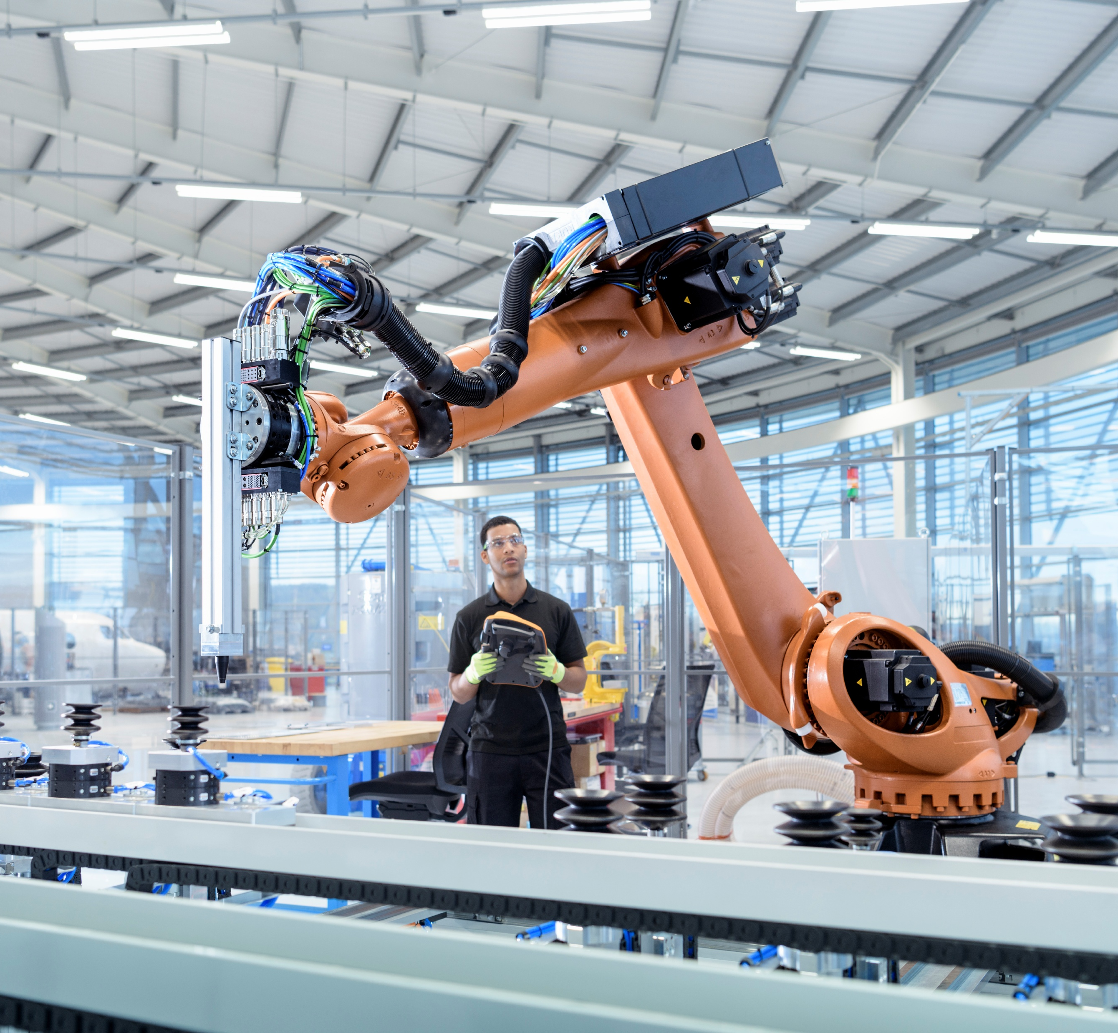
Progress & Next Steps
Cyber-Zero
Progress & Next Steps
• System requirements and use cases completed • ROS2 simulation environment operational • Pick-and-place chess move executed in simulation • Confirms feasibility of robotic execution • Integrate AI move calculation with simulation • Transition from simulation to physical robotic arm • Improve UI elements for better user experience • Complete full system integration

